Slide 1
Classification and Detection with Convolutional Neural Networks
Scott Lilleboe

Slide 2
Overview
Create a pipeline to detect and recognize digits in a single image
Must use a Convolutional Neural Network (CNN)
The sequences of digits will have varying scales, orientations, and fonts
Kick off the code sequence…

Slide 3
Pipeline
Simple Gaussian blur applied to images
Sliding window utilized at various scales
Needed to find a “sweet spot” where the steps in window scaling covered the image space adequately while not impacting overall prediction performance
Send image slices to the CNN for digit recognition
Filter CNN prediction values to suppress false positives
Use prediction thresholding, custom algorithms and non maximum suppression

Slide 4
Convolutional Neural Network (CNN)
VGG16
Pre-Trained on ImageNet data
Top 3 FCL removed and replaced with 3 FCL custom layers
11 Classes with a softmax activation

Slide 5

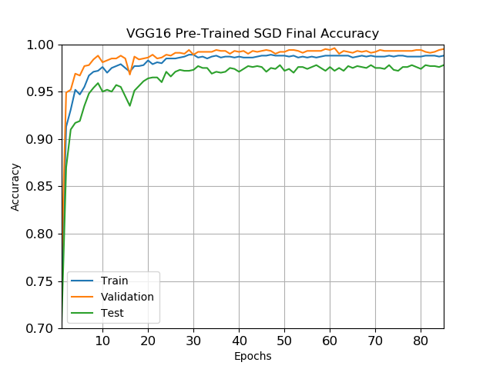
CNN model Learning curve
Reached 90% plus training, validation, testing accuracy after the first 2 epochs
After 85 epochs:
98.8% Training
99.4% Validation
98.2% Testing

Slide 6
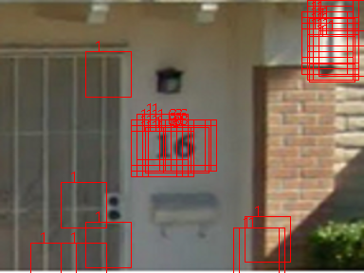
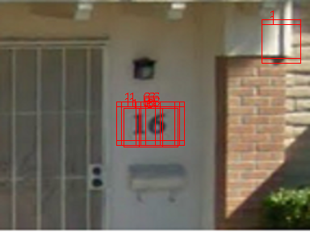
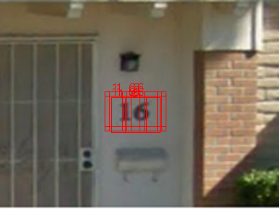
prediction filtering
Digit threshold filtering
Mean & Centroid distances
Mean filtering based on standard deviation from all the centroids
Average centroid distance for each detected digit filtering
Non Maxima Suppression (results on next slide)

Slide 7

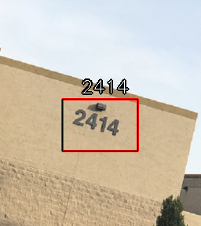
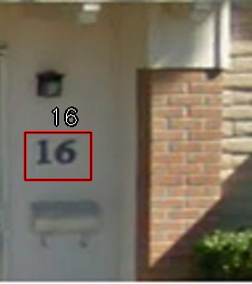
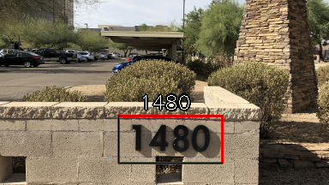
Positive Results
Different fonts
Scale invariance
Orientation & Rotation
Lighting (shadowing on bottom image)

Slide 8
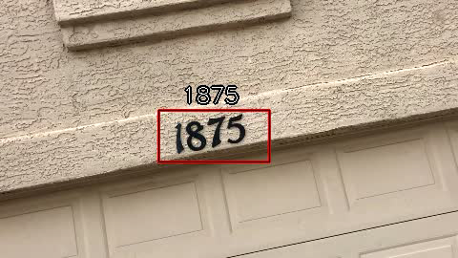
Example video

Slide 9
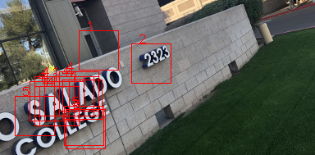

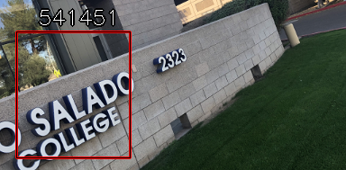
Negative results
Text disrupted recognition
Mean cluster filtering worked but removed the only positive result
Didn’t train on skewed digits
Sliding window scaling was not robust enough

Slide 10

Lessons learned
GPU vs CPU
7s vs 50s per image
Start simple
Work on less complicated images first
Prototype quickly
Create smaller train/validation/test sets to iterate over more parameter/model combinations quickly

Slide 11
The End
Check the code!

